Slide 1


Spotify Trends Analysis
Status 05.10.2023
Marianne STEPHANIDES
Merve TASKAYA
Bernhard WEGHAUPT
Tomasz WLODARSKI

Slide 2
Preprocessing Steps
Preprocessing Steps
Genres:
convertion into list
lowercase
remove characters
Tokenization
No „classic“ stoppwords
EDA

Slide 3
Preprocessing Steps
Preprocessing Steps
Lyrics:
Replace ‚\r\n‘ with space
Detect language
Translate lyrics into english (failed so far – filter english songs)
Lowercasing
Tokenization
Removing Stopwords
EDA

Slide 4
EDA
Preprocessing Steps
Statistics for Genres:
Number of Documents: 32589 Average Document Length: 2.68 words Minimum Document Length: 1 words Maximum Document Length: 30 words Vocabulary Size: 2453 unique words
EDA

Slide 5
EDA
Preprocessing Steps
Statistics for Genres:
Number of Documents: 32589 Average Document Length: 2.68 words Minimum Document Length: 1 words Maximum Document Length: 30 words Vocabulary Size: 2453 unique words
EDA

Slide 6
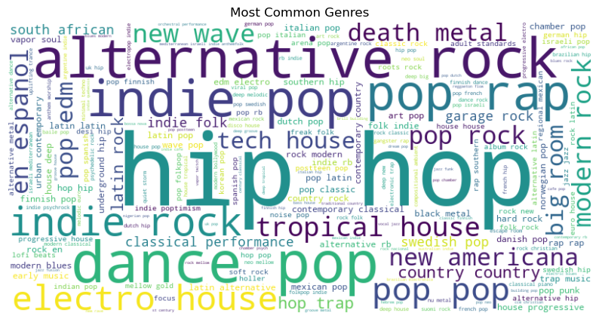
EDA
Preprocessing Steps
EDA

Slide 7
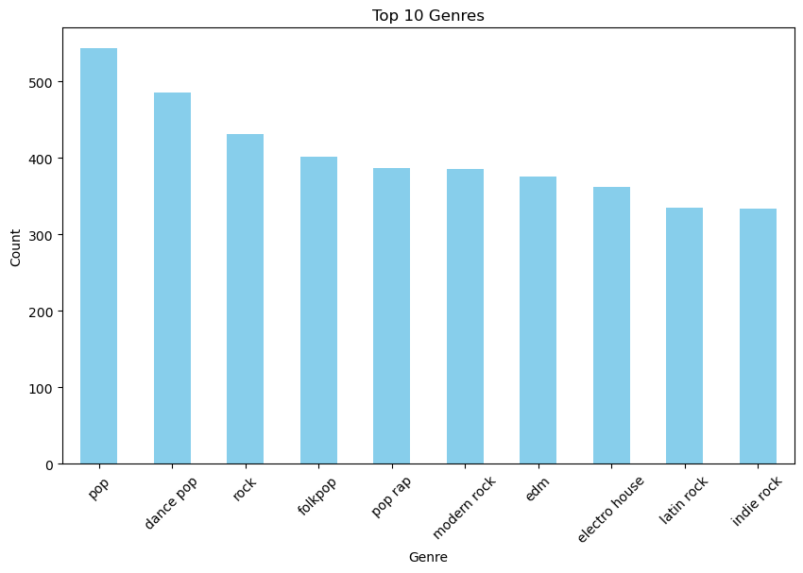
EDA
Preprocessing Steps
EDA

Slide 8

EDA
Preprocessing Steps
Statistics for lyrics:
40.816 unique lyrics
Different languages
EDA

Slide 9
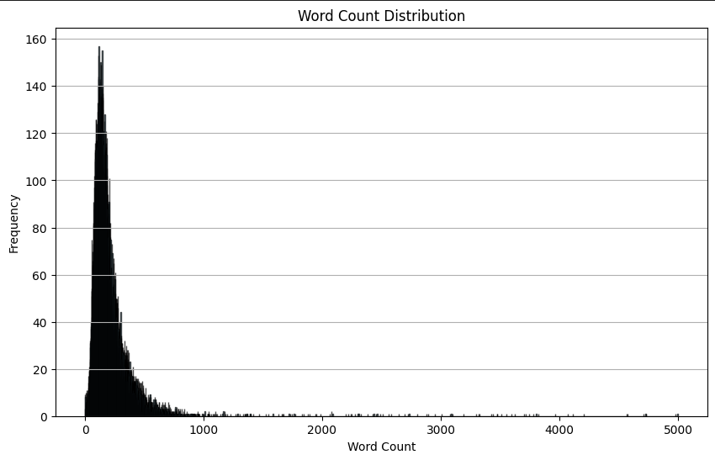
EDA
Preprocessing Steps
EDA

Slide 10

Thank You

